Slide 1
Predicting High Income Using Machine Learning
Adult Census Dataset — Logistic Regression & XGBoost
12/07/2025

Slide 2

Project Objective
Build a model to classify whether an individual earns > $50K annually
1
Understand key socioeconomic factors behind income
2
Compare baseline model (Logistic Regression) with XGBoost
3
Interpret model behavior using Feature Importance+ SHAP
4

Slide 3

Dataset Overview
Adult Census dataset (48,842 rows, 15+ features)
Target variable: high_income (1 = >50K, 0 = ≤50K)
Features include:
Age, education, marital status
Occupation, capital gain/loss
Hours per week
Demographics & work information

Slide 4

Data Cleaning & Preparation
Replaced '?' with NaN
Grouped many categorical variables into simpler categories
Converted categorical features → dummy variables
Final dataset ready for ML modeling

Slide 5

Train/Test Split
80/20 split
stratify=y to preserve class balance
Scaling applied inside pipelines
Prevents data leakage and ensures proper CV evaluation

Slide 6

Logistic Regression (Baseline) VS XGBoost
Performance
Accuracy: ~0.85
Precision (Class 1): 0.75
Recall (Class 1): 0.59
F1 (Class 1): 0.66
Interpretation
  Strong at predicting low-income individuals
  Misses many high-income individuals (class imbalance effect)
  Serves as our baseline benchmark
XGBoost Performance
Accuracy: ~0.89
Precision (Class 1): 0.83
Recall (Class 1): 0.69
F1 (Class 1): 0.75
Interpretation
  Performs better in predicting low-income individuals (class 0) and high-income individuals (class 1)

Slide 7

Why Logistic Regression Struggles
Dataset is imbalanced (high-income minority group)
Relationships among variables are nonlinear
Logistic regression is a simple model → cannot capture interaction effects (e.g., education × marital status × occupation)
➡️ Need a more flexible model → XGBoost
Notes:
Conclusion: XGBoost handles nonlinear relationships and imbalanced patterns better.

Slide 8
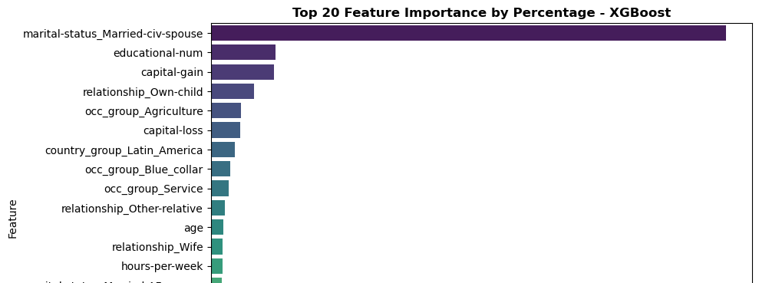
SHAP Summary Plot
Top influential features:
  Marital-status (married → much higher income probability)
  Education level
  Capital-gain

Slide 9
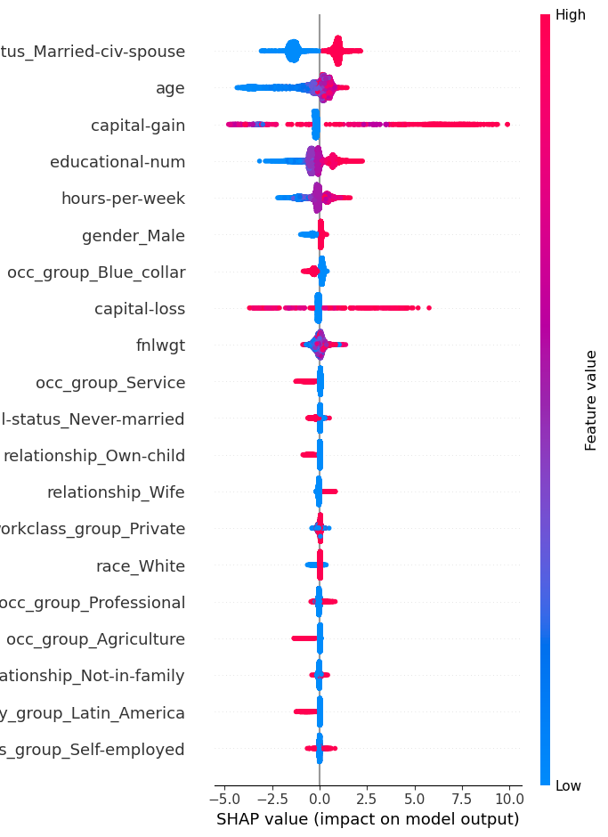
SHAP Summary Plot
Top influential features:
  Marital-status (married → much higher income probability)
  Age
  Capital-gain
  Education level
  Hours-per-week

Slide 10
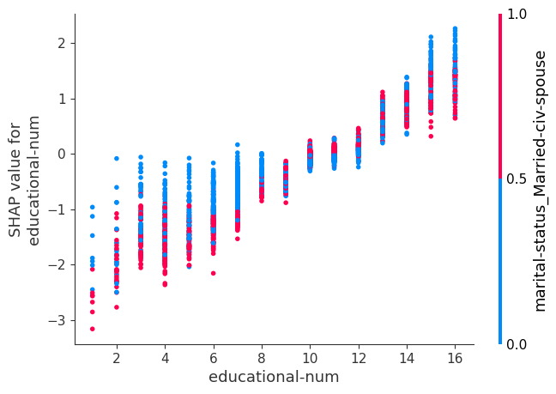
SHAP: Hours-per-Week Effect
Working < 30 hours/week strongly predicts low income
Working > 40 hours/week increases probability of high income
Marital status amplifies the effect (married people tend to work more & earn more)

Slide 11
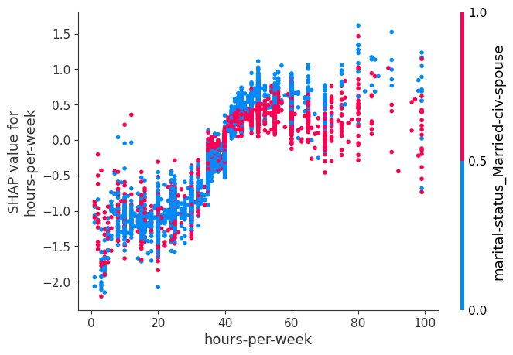
Hours-per-Week Effect
Working < 30 hours/week strongly predicts low income
Working > 40 hours/week increases probability of high income
Marital status amplifies the effect (married people tend to work more & earn more)

Slide 12


